Slide 1

Academic Session 2025-26
Even Semester Jan-Jun’26
Apex Institute of Technology
Department of Artificial Intelligence and Machine Learning
System Design (23CST-390)
Faculty: (Er.) Kamaljeet Kaur (E19147)
DISCOVER . LEARN . EMPOWER
Lecture
Introduction to System Design

Slide 2
Learning Objectives
Understand the fundamental concepts of system design and its importance in building
scalable applications.
Learn the principles of scalability, availability, and reliability in large systems.
Differentiate between Monolithic and Microservices architectures.
Explain key performance metrics such as latency and throughput.
Understand how caching improves system speed and reduces load on backend services.

Slide 3
Course Outcomes
On completion of this course, the students shall be able to:-
CO1 | Understand the fundamental system design principles, including scalability, high availability, and fault tolerance, while analyzing how these core principles influence architectural decisions in real-world distributed environments.
CO2 | Apply various distributed architectural patterns, key database models (SQL and NoSQL), and critical communication protocols to evaluate their specific applications and trade-offs in modern system designs.
CO3 | Apply advanced scaling techniques, such as caching, load balancing, database sharding, and replication, to design system components that effectively handle massive user traffic and data volumes.
CO4 | Analyze the trade-offs between different system architectures, data storage solutions, and consistency models (like the CAP theorem) to select and justify optimized configurations for performance, cost, and reliability goals.
CO5 | Create and document comprehensive, end-to-end system designs that are inherently scalable, distributed, and fault-tolerant, leveraging modern paradigms such as cloud computing and microservices architecture.

Slide 4
Unit-1 Syllabus
Unit-1 | System Design
Introduction to System Design | Introduction to System Design, Functional & Non-Functional Requirements, Scaling Challenges, Load Balancing, Caching Strategies, Replication, Sharding.
Databases in System Design | Databases in System Design – SQL vs NoSQL, CAP Theorem, Distributed Databases, Consistency Models, Eventual Consistency, Distributed Caching (Redis, Memcached), High Availability, Fault Tolerance, Microservices vs Monolithic Architecture.

Slide 5
Topic to be Covered
      Eventual Consistency
How Eventual Consistency Works
Strong Consistency vs Eventual Consistency
How Eventual Consistency Works
Advantages of Eventual Consistency
Challenges in Eventual Consistency

Slide 6
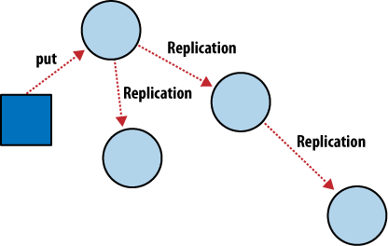
Eventual Consistency
9
Eventual Consistency is a weak consistency model used in distributed systems where:
Data updates happen at different replicas asynchronously.
Temporary inconsistency is allowed
All replicas become consistent eventually, after updates propagate.
It is commonly used when availability and performance matter more than immediate accuracy.

Slide 7
Why Eventual Consistency is Needed?
High Availability
Systems remain available even if some nodes are down or disconnected.
Low Latency
Reads and writes happen quickly because they do not wait for all replicas to sync.
Scalability
Supports globally distributed systems (Google, Amazon, Meta).

Slide 8
How Eventual Consistency Works
It works in 4 steps
A client writes data to a single replica or leader node.
The update is added to a replication log.
Replicas receive the update asynchronously.
All replicas converge to the same state over time.

Slide 9
Strong Consistency vs Eventual Consistency
Aspect | Strong Consistency | Eventual Consistency
Data Sync | Immediate | Delayed
Read Behavior | Always latest data | Might see stale data
Availability | Lower | Very high
Latency | Higher | Very low
Use Cases | Banking, payments | Social media, messaging
Aspect | Strong Consistency | Eventual Consistency
Data Sync | Immediate | Delayed

Slide 10
Advantages of Eventual Consistency
High Availability
Nodes can continue to accept writes, even during network failures.
Fault Tolerant
System keeps running even when some replicas are unreachable.
High Performance
Reads and writes don’t wait for global synchronization
Supports Geo-Distributed Users
Users in different countries get low-latency access.

Slide 11
Challenges in Eventual Consistency
Stale Reads
Users may read old data before replicas sync.
Conflict Resolution
If two users update the same data at the same time, conflicts must be resolved.
Difficult to Reason About
Developers must design applications expecting temporary inconsistency.

Slide 12
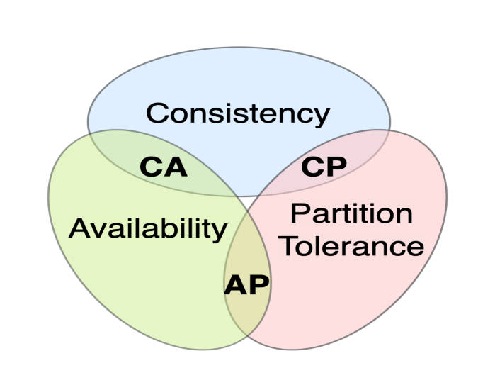
Eventual Consistency in CAP Theorem
In a distributed data store, you can only guarantee two of the following three:
Consistency: Every read receives the most recent write.
Availability: Every request receives a response (even if data is stale).
Partition Tolerance: The system works despite network failures.

Slide 13
Summary of the Lecture
1. Eventual Consistency is a weak consistency model used in distributed systems.
It ensures that all replicas will become consistent after some time, but not immediately.
2. Updates are replicated asynchronously across nodes.
The system does not wait for all replicas to update before responding.
3. Data may be temporarily inconsistent.
Different replicas may return different values until synchronization completes.
4. Guarantees that replicas converge to the same value eventually.
As long as no new updates occur, the system reaches a consistent state.
5. Prioritizes high availability and low latency.
Reads and writes are fast because replicas are not locked for synchronization.
6. Supports large-scale, distributed, fault-tolerant systems.
Used where uptime and performance are more critical than strong consistency.

Slide 14
Next Lecture
Distributed Caching (Redis, Memcached)
Designing for Millions of Users
Rate Limiting Basics

Slide 15
Quiz
2. Eventual Consistency prioritizes which factor?
A. Strong consistency
B. High availability
C. High memory usage
D. Expensive hardware
3. In Eventual Consistency, updates are…
A. Synchronous
B. Immediate on all replicas
C. Asynchronous
D. Blocked until all writes complete
4. Eventual Consistency belongs to which CAP category?
A. CP
B. AP
C. CA
D. None

Slide 16
FAQ’s
1. Why is Eventual Consistency used?
It provides high availability, low latency, and fault tolerance, especially in large distributed environments.
2. Does Eventual Consistency mean the data is always correct?
No. During replication delays, users may read old or inconsistent data, but the system eventually becomes correct.
3. Where is Eventual Consistency commonly used?
NoSQL databases (Cassandra, DynamoDB, Riak)
Cloud storage (Amazon S3)
Social networks feeds
Caching and CDNs

Slide 17
References/ Articles/ Videos
Book Reference:
Designing Data-Intensive Applications – Martin Kleppmann Chapters on scalability, reliability, load balancing, replication.
Site Reliability Engineering (SRE) – Google Concepts on reliability, traffic management, and load distribution.
Tutorial Link:
https://www.youtube.com/watch?v=wLNE90bFfsA
Video Link:
https://www.youtube.com/watch?v=rpqsSkTIdAw

Slide 18

Class-Wise Feedback

Slide 19
Thank You
For queries Email: kamaljeet.e19147@cumail.in

